Slide 1
TERM PAPER PRESENTATION
Are Emergent Abilities in Large Language Models just In-Context
Learning?
Presented by
K Sethu Srivatsa(202218021)
Rutul Patel(202218036)
Kamal Yadav(202218047)

Slide 2
Motivation for the problem statement
Large language models have exhibited emergent abilities, demonstrating exceptional performance across diverse tasks.
Emergence is the ability to solve a task which is absent in smaller models, but present in LLMs. The ability of LLMs to perform well above the random baseline on tasks that cannot be solved through memorisation and are indicative of certain “abilities”, without explicit training on those tasks is called emergence.
It has been argued that the unpredictability associated with such emergent abilities underscores the possibility that these models might harbour latent hazardous abilities(especially while related to functional linguistic abilities) that manifest unexpectedly.
The authors aim to address these concerns by clarifying the nature of emergent abilities and demystify claims about emergent abilities to ensure the responsible use of LLMs in diverse applications.
They emphasise that the development of explicit linguistic proficiencies does not pose inherent risks.

Slide 3
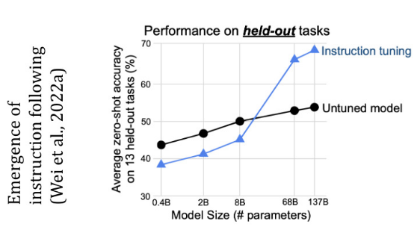
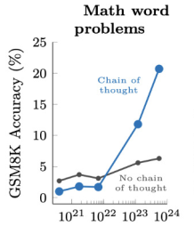
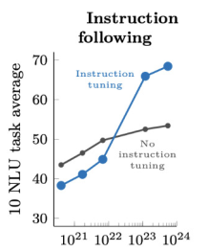
Problem Formulation
Authors notice that the combination of formal linguistic abilities, the capacity to retain and recall large amounts of information and, significantly, in-context learning lead to abilities in LLMs.
In-context learning implements gradient descent implicitly and constructs a function at inference time and hence is predictable and not emergent.
Performance of LLMs degrades in adversarial settings, thus indicating that, although LLMs exhibit some level of proficiency in abstract task-solving, they lean towards employing context-specific approaches.
LLMs does improve progressively with scale, but, when using discrete evaluation metrics, such improvements are only detectable when they tip over a threshold, thus giving the illusion of ‘emergence’. With the use of continuous metrics, such as string edit distance, it makes emergent abilities more predictable, thereby challenging their emergent status.
Truly emergent abilities are learnt in LLMs due to in-context learning and instruction tuning. Proficiency only indicates models’ ability to memorise information. It is found that prompting techniques manifest themselves at the same scale as the emergence of a significant number of abilities. Hence it is important to ascertain the extent of these emergent abilities in the absence of prompting techniques.
Prompting techniques, while offering novel avenues for leveraging models, do not pose safety concerns as usually believed as the outcomes they generate are predictable and reliant on user inputs.
Formal and functional linguistic abilities are differentiated by the authors for the first time and language models are probed using strategies that do not trigger in-context learning and instruction tuning.
Authors explore various research questions like finding out the abilities are truly emergent in the absence of in-context learning and evidence for the emergence of ‘reasoning’ in instruction-tuned models.
Emergent abilities detected by other authors based on above-random performance occurred as they did not differentiate between formal, functional linguistic abilities and did not consider effects of prompting techniques.
We could see how model performance increases with prompting techniques.

Slide 4
Approach (Model Architecture, Training Method)
They conducted rigorous tests on 18 models from 4 families( GPT, T5, Falcon and LLaMA) with a parameter range from 60 million to 175 billion parameters, across 22 tasks, of which some were emergent, non emergent and unsolvable by LLMs.. They included both instruction-tuned and non-instruction-tuned models.
To ensure fair evaluation , potential biases that could influence our findings are identified and experiments are designed to mitigate such biases.
Various prompting strategies used: Refining all prompts to ensure their solvability in absence of instruction comprehension (Completion-style prompt) and closed, closed(with adversarial prompt), open completion-style prompts.
Various tasks are performed like modified arithmetic, phrase relatedness, physical intuition, social IQA, and strange stories.
Evaluation metrics like BERTScore are used which measure semantic similarity. For numerical outputs, authors limit evaluation to exact matching to reflect numerical proximity.
Other discrete evaluation metrics like string - edit distance and continuous-BERTScore are also used.
Manual post-hoc analysis of a subset of the outputs generated by models which are not instruction-tuned is done to not over penalize non instruction-tuned models.
Each experiment is performed for three times and then average result is calculated.

Slide 5
Evaluation of Model
For a task to be considered emergent (Emg.), models must perform above the baseline (> Base.) and the performance of the larger models must not be predictable based on that of smaller models (Pred.)
Only two out of 14 previously-emergent tasks displayed true emergence, Nonsense-Grammar-Words in formal linguistic abilities and Hindu-Knowledge in memorization, both not involving reasoning. Hence reasoning abilities are not emergent in LLMs.
Exact match accuracy tends to be consistently lower compared to the BERTScore accuracy. In Few Short Prompting both appear closer. For Instruction-tuned models, performance degrades in the zero-shot setting. Therefore instruction-tuned models, benefit from the use of in-context learning both indirectly (through instruction tuning) and also directly (in the few-shot setting).
For LLMs that haven't been instruction-tuned, a qualitative analysis demonstrates the models' inherent understanding of task requirements, exemplified in tasks like 'causal judgement,' where the model generates appropriate responses without instruction tuning, further validated through manual analysis. Here we find that in majority cases automatic metric overestimates performance.
Relaxed version of adversarial prompting is used to detect emergence for non instruction tuned models, only to find them being predictable based on small models or memory based and therefore, non emergent.
When employing a discrete metrics, especially in the absence of in-context learning, there is no sudden performance increase in large models.
Instruction tuning triggers incontext learning and LLMs models possess an improved capacity to utilise their inherent in-context learning abilities, which is acquired through instruction tuning.

Slide 6
Evaluation (Continued) and Conclusion
T-5 family models which are instruction tuned, generate good performances above the random baseline reaffirming that capacity to comprehend and adhere to instructions is pivotal to T5’s prowess in tackling tasks of this magnitude.
GPT family models which leverage in-context learning does better in few shot learning. GPT family and T-5 family despite being different models have a overlap in tasks where above baseline performance is shown, proving that instruction tuning appears to enhance in-context learning efficiency more than reasoning abilities.
The effectiveness of instruction tuning remains consistent even with increased scale or additional training on instructional datasets, suggesting no significant indication of latent hazardous abilities.
LLMs follow instructions without reasoning to produce output consistent with instructions due to combination of memory and in-context learning.
Despite good zero-shot capabilities, in the absence of explicit examples, LLMs struggle, showing that prompt engineering, as well as instruction and example design, are crucial for optimal LLM performance.
Design of tasks that test specific abilities of LLMs, should always be checked to avoid unpredictable and dangerous behaviours of models.
The authors instill trust in language models by recognizing their absence of latent hazardous abilities, as they are not emergent but influenced by in-context learning, and give public understanding to alleviate safety concerns.
Authors advocate for increased transparency in disclosing facets like impact of scale, pre-training, and instruction tuning when applied on the LLMs.
We would display the results on the following page.

Slide 7
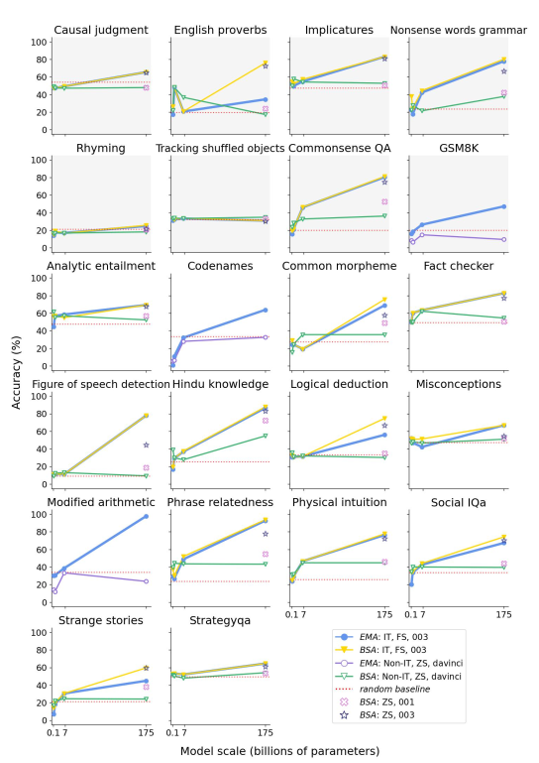
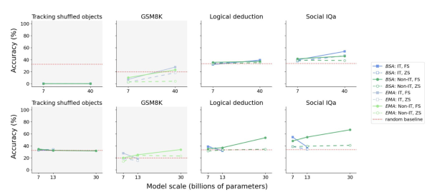
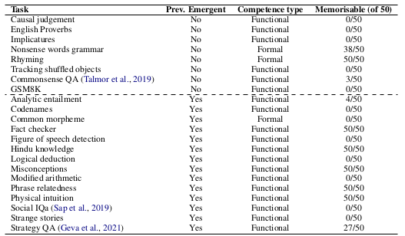
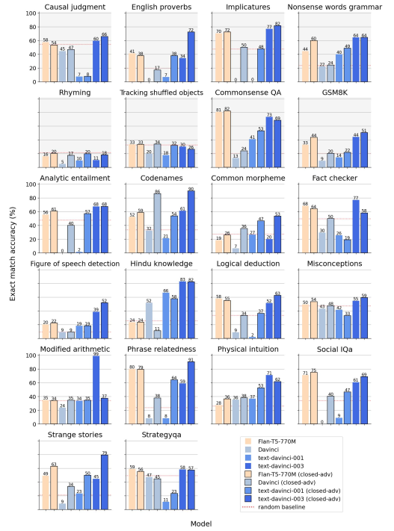
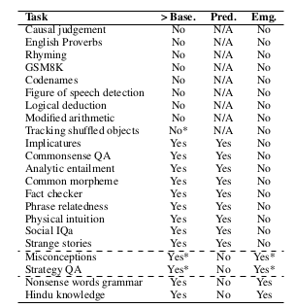
(B)
(D)
(A)
[A,B,C,D,E]. Fig A shows list of the tasks used in our experiments, along with their previous identification as emergent or otherwise. Fig B shows Falcon (top) and LLaMA (bottom) in the non-instruction-tuned zero shot setting. Fig C shows Instruction-tuned and non-instruction-tuned are evaluated in the few-shot (FS), zero-shot (ZS) settings using BERTScore accuracy (BSA) and the Exact Match Accuracy (EMA). It shows significant overlap in tasks where both Flan-T5 and GPT-3 perform above
Baseline. Fig D shows non-instruction-tuned models in the zero-shot setting. Fig E shows performance of models from the GPT family.
(E)
(C)

